Slide 1
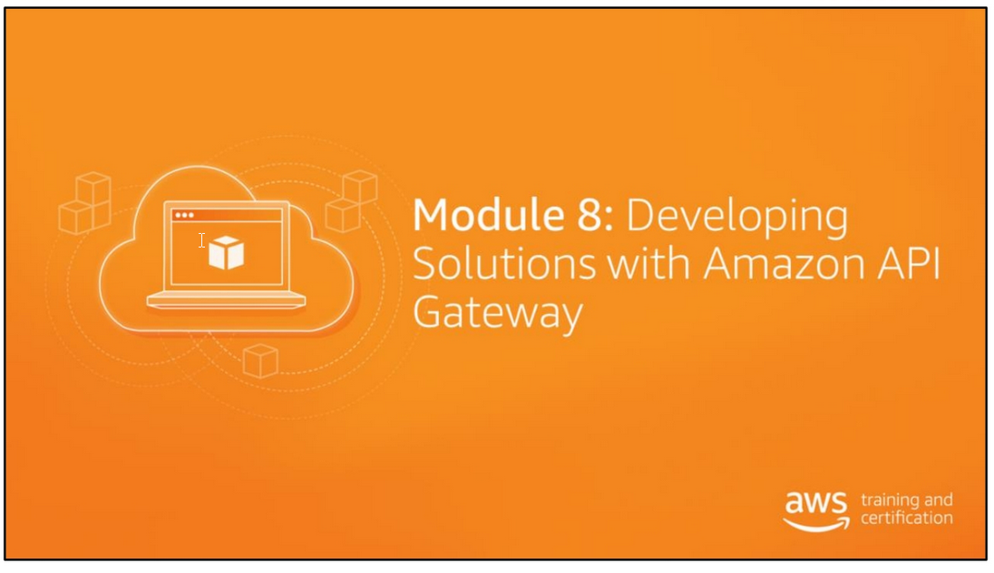

Slide 2
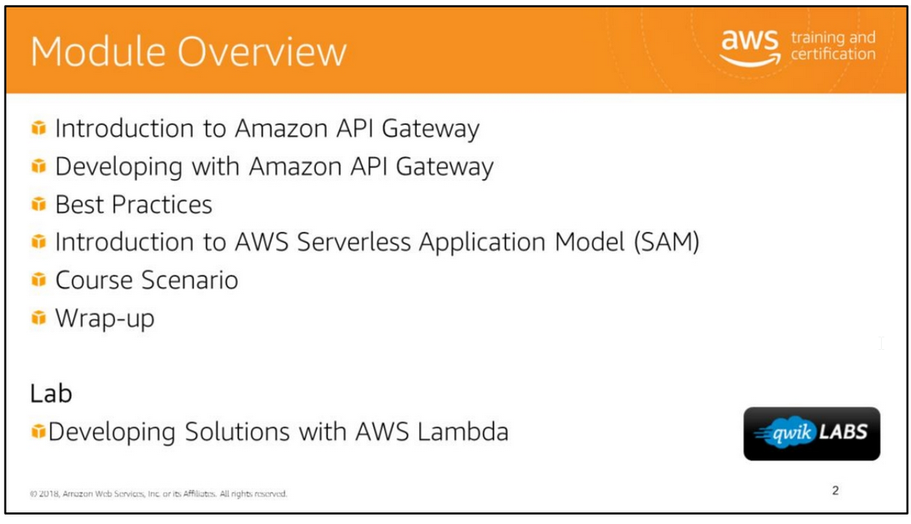

Slide 3
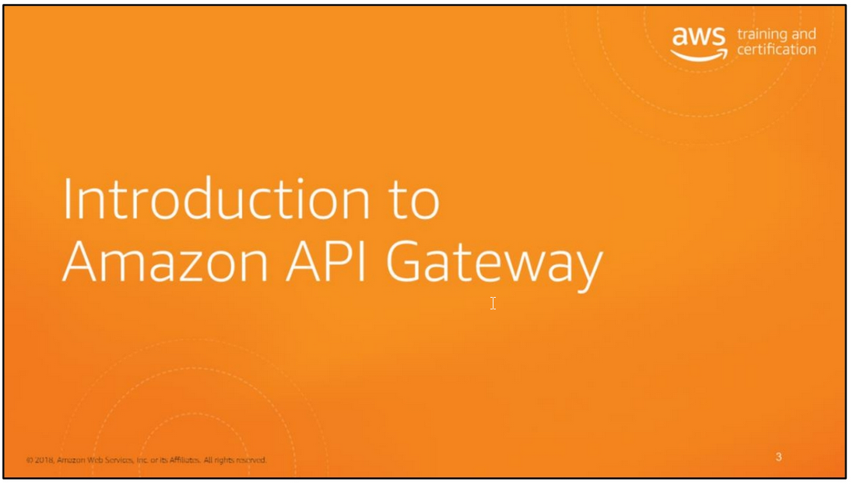

Slide 4
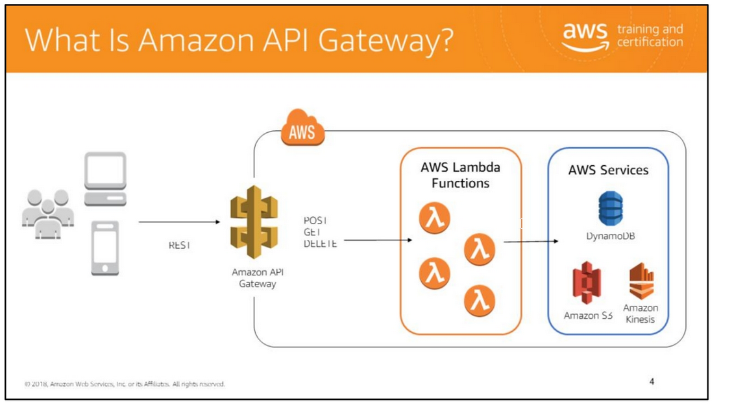
Amazon API Gateway enables developers to create, publish, maintain, monitor, and secure APIs.
API Gateway allows you to connect your applications to AWS services and other public or private websites.
It provides consistent RESTful application programming interfaces (APIs) for mobile and web applications to access AWS services and other resources hosted outside of AWS.
As a gateway, it handles all the tasks involved in accepting and processing up to hundreds of thousands of concurrent API calls, including traffic management,
authorization and access control, monitoring, and API version management.

Slide 5
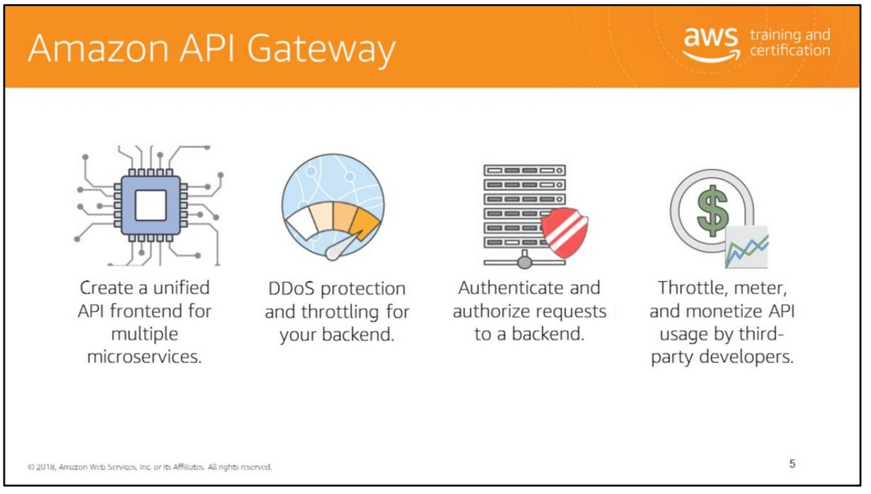

Slide 6
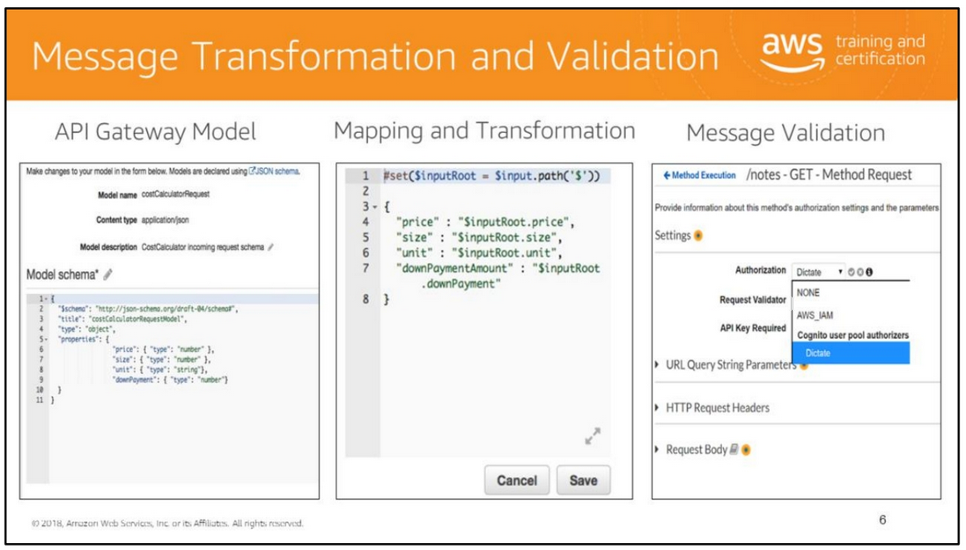
API Gateway offers message transformation and validation. Models can be created to define a schema for request/response messages.
The request/response payload and header can be validated against the model. Finally, message transformation and mapping can be done using API Gateway.
Customers will often map request messages to a canonical format for downstream applications using API Gateway

Slide 7
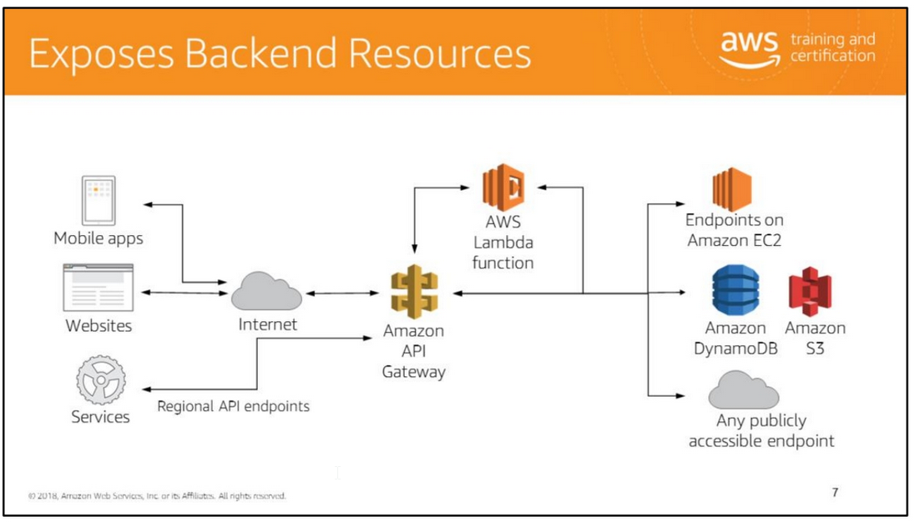
Amazon API Gateway allows you to create an API that acts as a front door for applications to access data, business logic, or functionality from your backend services,
such as workloads running on Amazon Elastic Compute Cloud (Amazon EC2), code running on AWS Lambda, or any web application. Exposes backed resources such as:
• HTTP endpoints
• AWS Services
• AWS Lambda functions Amazon API Gateway lets you operate multiple API versions and multiple stages for each version simultaneously so that existing applications can continue
to call previous versions after new API versions are published.

Slide 8
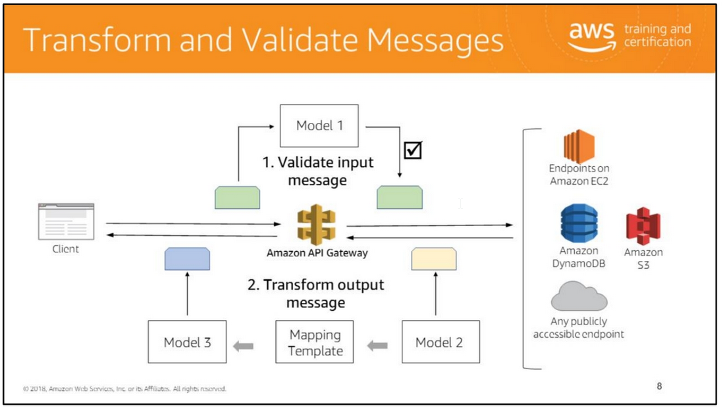
API Gateway can perform message transformation and validation:
• Models can be created to define a schema for request and response messages.
A Mapping Template can then be used to transform data from one model to another.
This is useful to transform a request body from the frontend data format to the backend data format, or transform a response body from the backend data format to the frontend data format.
• The request/response payload and header can be validated against a model to ensure that the data that is exchanged between the client and the backend is in the proper format.

Slide 9
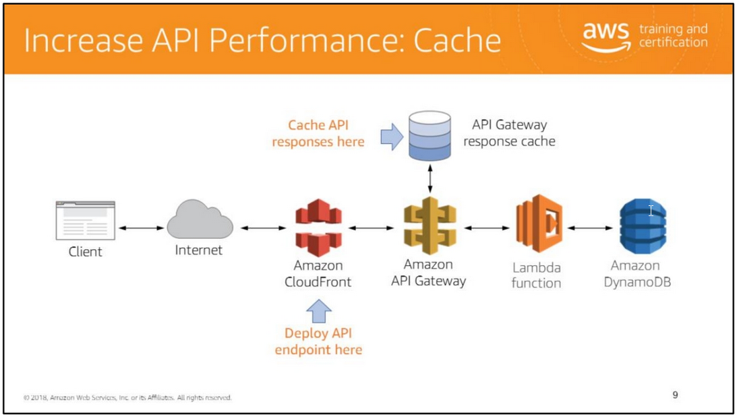
Deploy APIs to Regional or Edge-optimized endpoints to bring them closer to their clients. Cache API responses to the API Gateway response cache.
When creating an API, Amazon API Gateway gives you the option to choose one the following endpoint types to increase performance:
• Regional: Regional APIs are deployed in the current region.
When API requests predominantly originate from an EC2 instance or services within the same region as where the API is deployed,
a regional API endpoint will typically lower the latency of connections and is recommended for such scenarios.
• Edge-optimized: Edge-optimized APIs are deployed to the CloudFront network.
An edge-optimized API endpoint optimizes access to an API by being deployed to an Amazon CloudFront distribution that is geographically closer to the client.
You can also enable API caching in Amazon API Gateway to cache your endpoint’s response.
With caching, you can reduce the number of calls made to your endpoint and also improve the latency of the requests to your API. When you enable caching for a stage,
API Gateway caches responses from your endpoint for a specified time-to-live (TTL) period, in seconds.
API Gateway then responds to the request by looking up the endpoint response from the cache instead of making a request to your endpoint.
The default TTL value for API caching is 300 seconds.
The diagram on this slide shows the topology of an edge-optimized endpoint deployed to an Amazon CloudFront distribution. It also illustrates the use of API caching.

Slide 10
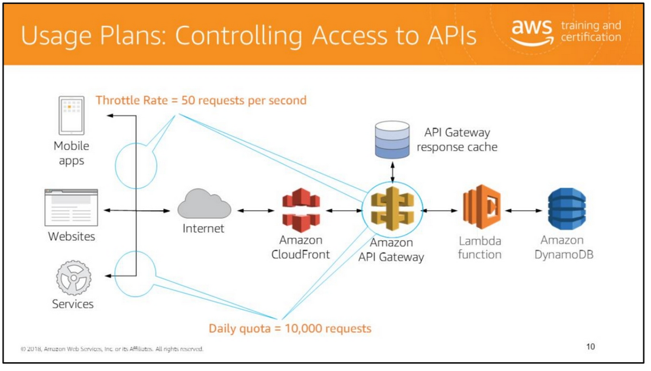
You can throttle and control API usage through:
• Method-level throttling
• Client usage throttling and quota limits specified in a Usage Plan
API Gateway throttling and quota limits can help prevent one customer from consuming all of your backend system’s capacity.
You can create various usage plans based on allowed request rate and burst limit. You can then assign a customer the proper usage plan that meets their business requirements and budget.
A usage plan prescribes who can access one or more deployed API stages (deployment environment), and how much and how fast the caller can access the APIs.
The plan uses an API key to identify an API client and meters access to an API stage with the configurable throttling and quota limits that are enforced on individual client API keys.
Here is an example of throttling and limiting specific consumers. In this case, you want limit your mobile consumers to invoke your API at a maximum rate of 50 requests per second.
For your partners, you want to enforce a quota of 10,000 request per day. © 2018 Amazon Web Services, Inc.

Slide 11
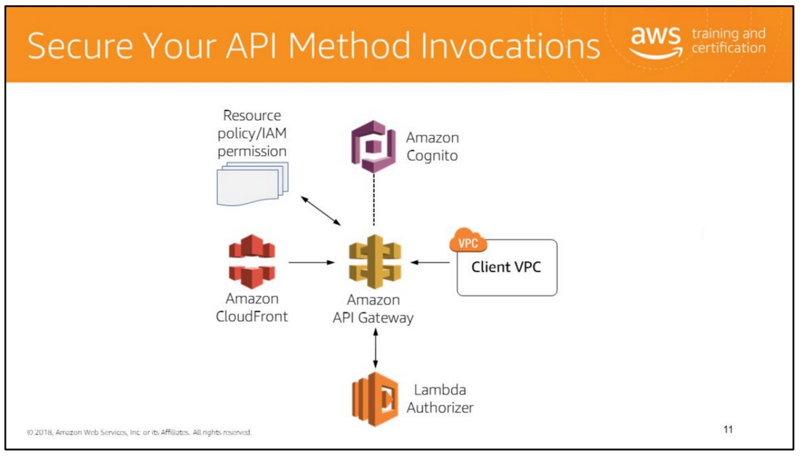
With API Gateway, you can secure the access to your APIs in various ways including:
• Creating a Resource policy. A Resource Policy is a JSON policy document that you attach to an API to control whether a specified principal (typically an IAM user or role) can invoke the API.
You can use a Resource Policy to enable users from a different AWS account to securely access your API or to allow the API to be invoked only from specified source IP address ranges
or Classless Inter-Domain Routing (CIDR) blocks. Attaching a policy applies the permissions in the policy to the methods in the API.
• Creating an Identity and Access Management (IAM) permission policy. Two types of policies are supported allowing you to protect:
• The creation, deployment, and management of an API
• The invocation of the methods in the API and the refresh of its cache.
• Creating a Private API endpoint that can only be accessed by a Virtual Private Cloud (VPC) client.
• Integrating with Amazon Cognito or Lambda authorizers to authenticate and authorize clients before accessing backend resources.
• Using Amazon CloudFront as security layer to protect against Distributed Denial of Service (DDoS) attacks.
The Resource policy and IAM permission capabilities offer flexible and robust access controls that can be applied to an entire API set or individual methods.
Lambda authorizers and Amazon Cognito user pools provide customizable authorization and authentication solutions
Lambda Authorizers were formerly known as Custom Authorizers

Slide 12
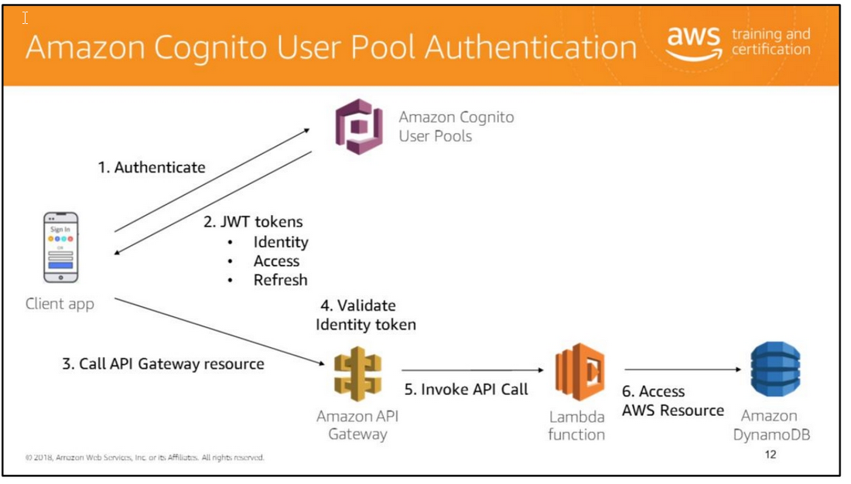
This example illustrates the how Amazon API Gateway makes use of Amazon Cognito User Pools for security purposes.
It shows the authentication and authorization flow when a client application attempts to invoke a Lambda function which accesses a backend database resource through Amazon API Gateway.
Note that in Step 2, the JSON Web Tokens (JWT) returned by Amazon Cognito contain the identity, access permission and cache refresh permission of the authenticated client.
Cognito User pools allow you to create and maintain a user directory. User pools scale to hundreds of millions of users and are designed to provide simple, secure, and low-cost options for you
as a developer. With Cognito, a user can sign-in using an email, a phone number, or a user name.
The user can also start as an anonymous user and then sign-in using a social identity.
A User Pool is our user directory. We can register users in the pool and users can authenticate with their credentials.
1. After users are registered, an authentication request is sent to the Cognito user pool.
2. The outcome of a successful authentication against User Pools is an Open ID Connect-compatible (OIDC) identity token and a JWT access token.
3. The Identify token is passed to the API Gateway in the Authorization Header to authenticate the client.
4. API Gateway is able to validate the identity token with Cognito.
5. If the request is authorized, the call is forwarded to the back-end service. 6. Access the AWS resource.

Slide 13
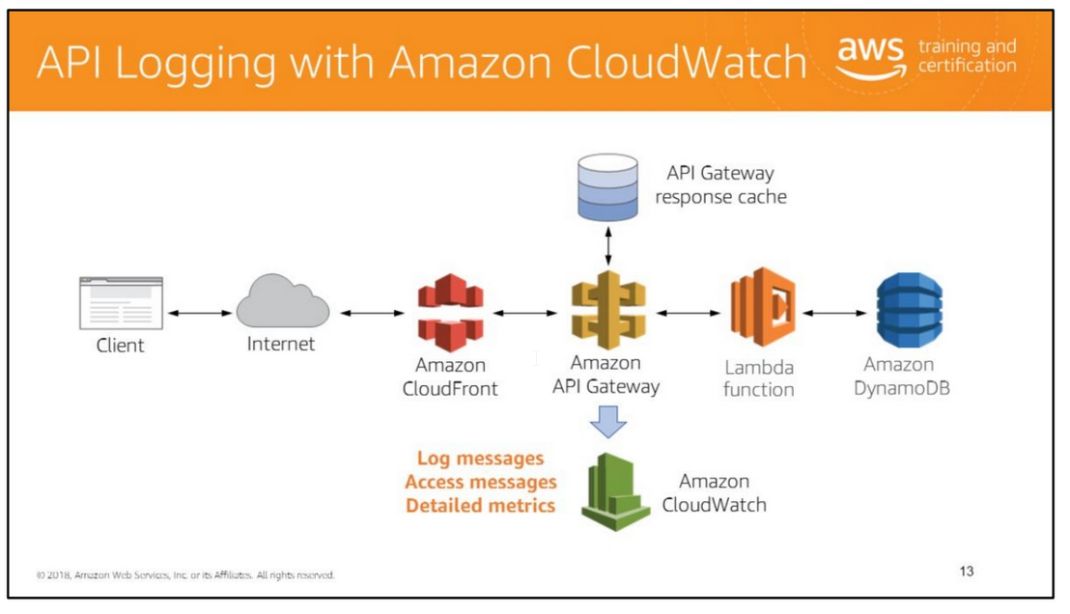
Amazon API Gateway integrates with Amazon CloudWatch by sending log messages and detailed metrics to it.
You can enable logging for each stage in your API or for each method. You can set the verbosity of the logging (Error or Info), and if full request and response data should be logged.
The detailed metrics that API Gateway can send to Amazon CloudWatch are:
• Number of API calls
• Latency
• Integration latency
• HTTP 400 and 500 errors
You can also enable access logging to log who has accessed your API and how it was accessed.

Slide 14
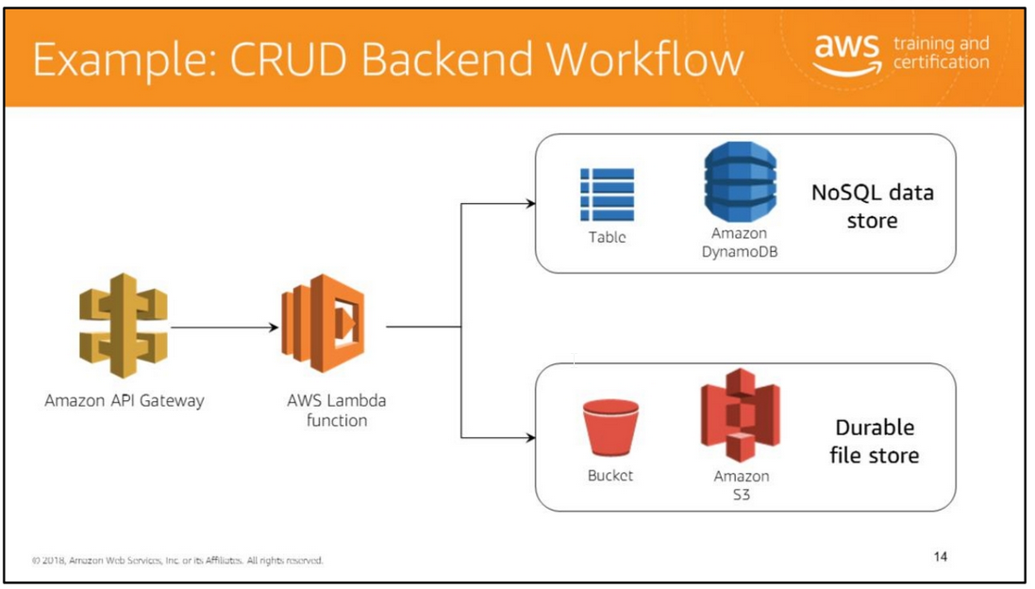
CRUD stands for "Create, read, update, and delete“. It refers to all of the major functions that are implemented in relational database applications.
An AWS Lambda function could be used as a CRUD backend, to intelligently handle a diverse array of API calls, whether to store them in a database or into a file store like Amazon S3.

Slide 15
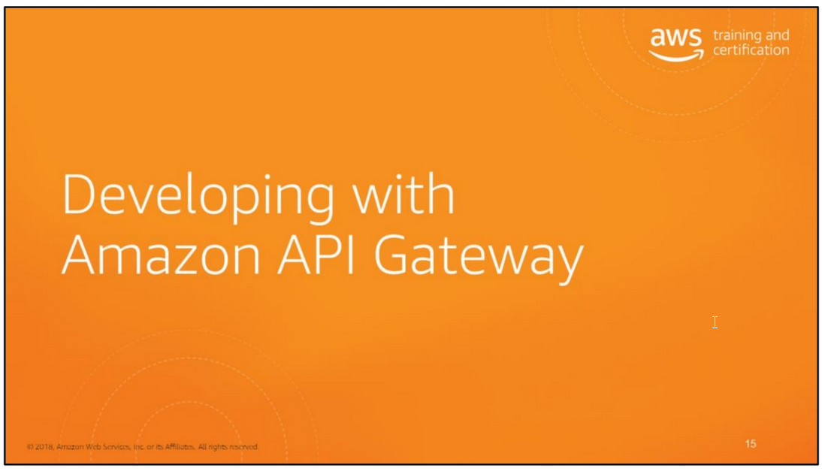

Slide 16
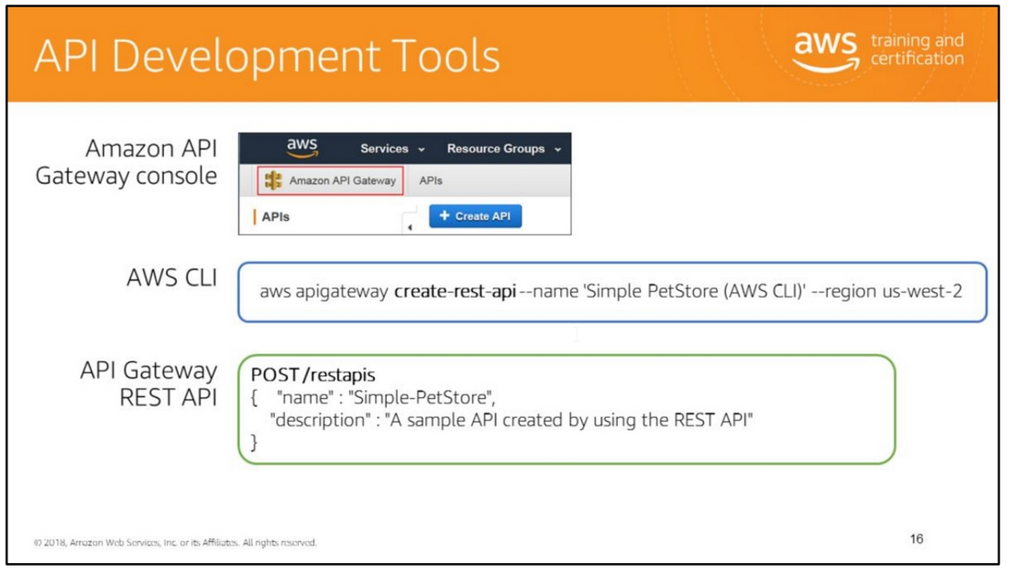
Through the Amazon API Gateway console, you can define the REST API and its associated resources and methods, manage the API lifecycle, generate client SDKs, and view API metrics.
You can also use the API Gateway console to define your APIs’ usage plans, manage developers’ API keys, and configure throttling and quota limits.
The console offers a wizard-driven way to create, test and deploy an API, and provides hints to help you navigate.
It is arguably the simplest and most straight-forward way to create an API.
Alternatively, you can use AWS CLI commands, the AWS SDK for your language platform or the API Gateway REST API.
The API Gateway REST API provides HTTP methods that you can invoke directly to create, configure, update, and deploy an API in API Gateway.
The other tools use the API Gateway REST API in the implementation of their functions.

Slide 17
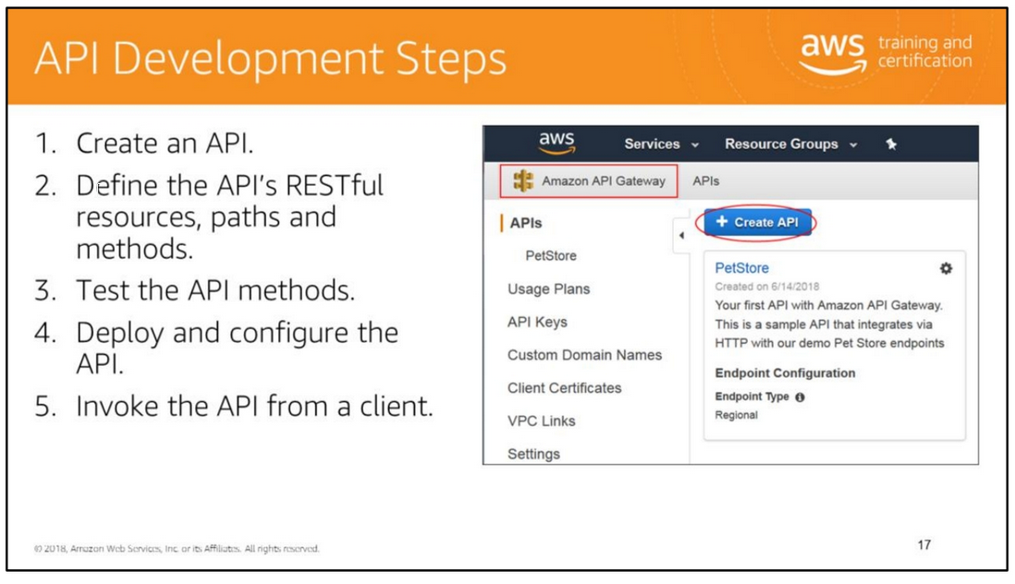
The main steps of the API development process consist of creating a resource, defining and exposing methods on the resource, and testing and deploying the API.
In the Amazon API Gateway console, you initiate the process by clicking Create API. The next slides describe these steps in the console in more detail.

Slide 18
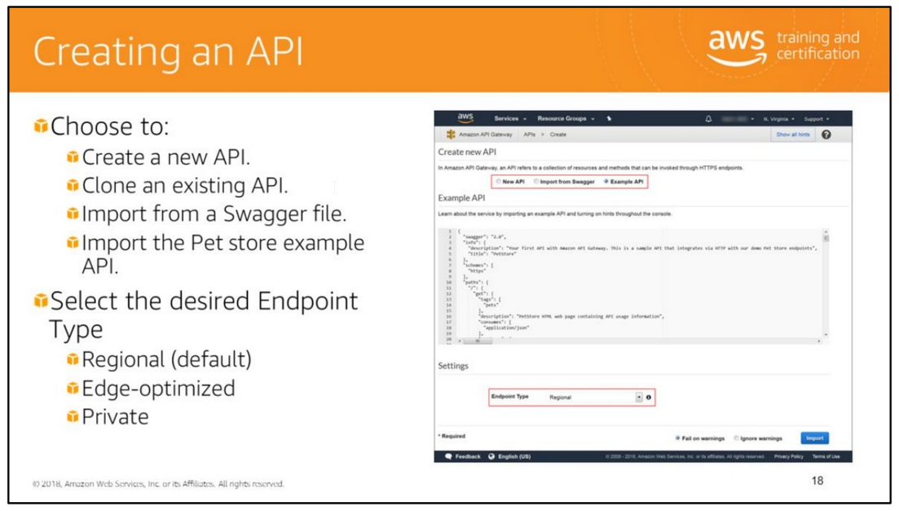
Selecting New API allows you to create an API from scratch.
Alternatively, if your API already exists and has a Swagger definition file, you can select Import from Swagger to import it into API Gateway.
You can also select to import the Example API which allows you to invoke the endpoint for the example PetStore website (http://petstore-demo-endpoint.execute-api.com/petstore/pets).
Finally, if you already have other APIs defined in API Gateway, you can choose to Clone from existing API.
Note that in the example above, this option is not displayed because no other APIs are defined.
The Endpoint Type determines how the API’s endpoints (front-end) are deployed and accessed by clients.
It can have the following values: • Regional: Regional APIs are deployed in the current region.
When API requests predominantly originate from an EC2 instance or services within the same region as where the API is deployed, a regional API endpoint will typically lower the latency
of connections and is recommended for such scenarios.
This is the default selection for Endpoint Type.
• Edge-optimized: Edge-optimized APIs are deployed to the CloudFront network.
An edge-optimized API endpoint optimizes access to an API by being deployed to an Amazon CloudFront distribution that is geographically closer to the client.
• Private: Private APIs are accessible only from Amazon Virtual Private Clouds (VPCs) using an interface VPC endpoint.

Slide 19
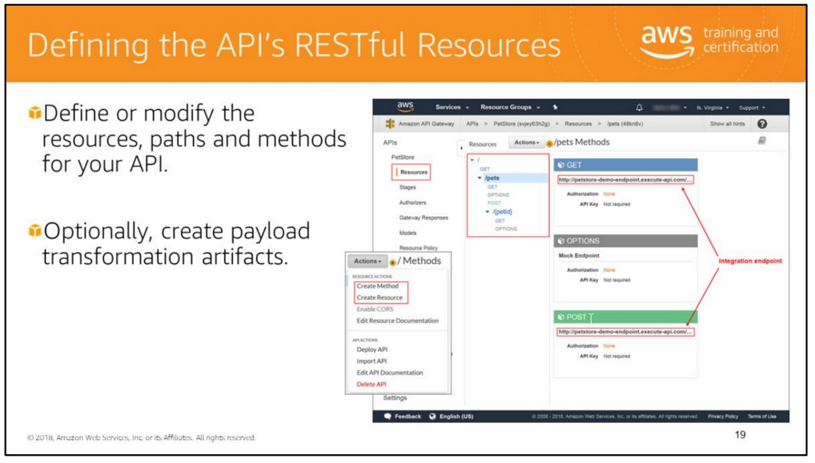
The Resources pane shows the structure of the created API as a tree of nodes. API methods defined on each resource are edges of the tree.
When a resource is selected, all of its methods are listed in the Methods pane on the right.
Displayed under each method is a brief summary of the method, including its endpoint URL, authorization type, and API Key requirement.
With Amazon API Gateway, you can provide your clients with a consistent and scalable programming interface to access three types of endpoints in the backend:
• AWS Lambda functions
• AWS services
• HTTP endpoint, website or webpage
For each API method that you define, you identify the backend endpoint to integrate with.
In API Gateway, a model defines the data structure of a payload and is described using a JSON schema format.
A mapping template can be used to translate the data from one model to another.

Slide 20
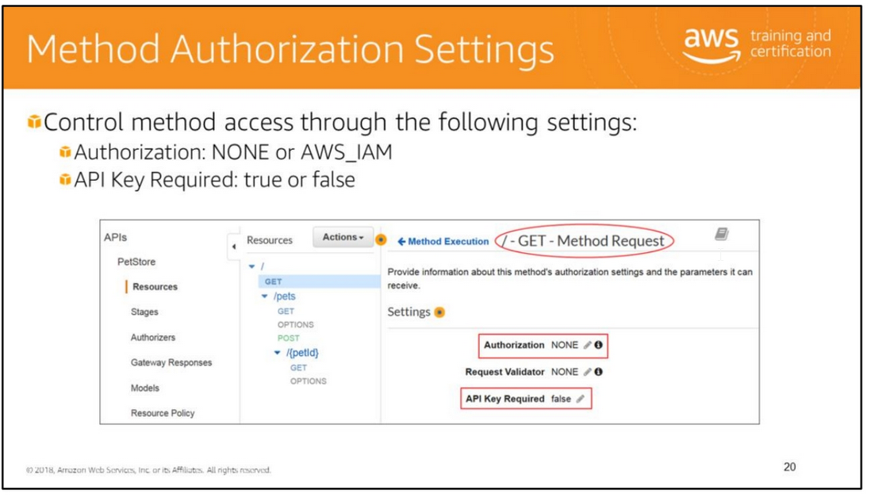
The valid values for Authorization are:
• NONE: No client authentication is performed, and the method is open for access to any user.
• AWS_IAM: This selection causes API Gateway to use IAM permissions to control client access to the method.
Only users in an IAM role with permission to access the method are allowed to call it.
Specifically, the client must sign the request with an AccessKey and corresponding SecretKey as provisioned by AWS IAM to invoke the method.
To do this, the client must support the Signature Version 4 (SigV4) protocols.
To require an API key to invoke the method, set API Key Required to true. Note you also need to enable API keys if you want to use a usage plan to throttle client traffic.

Slide 21
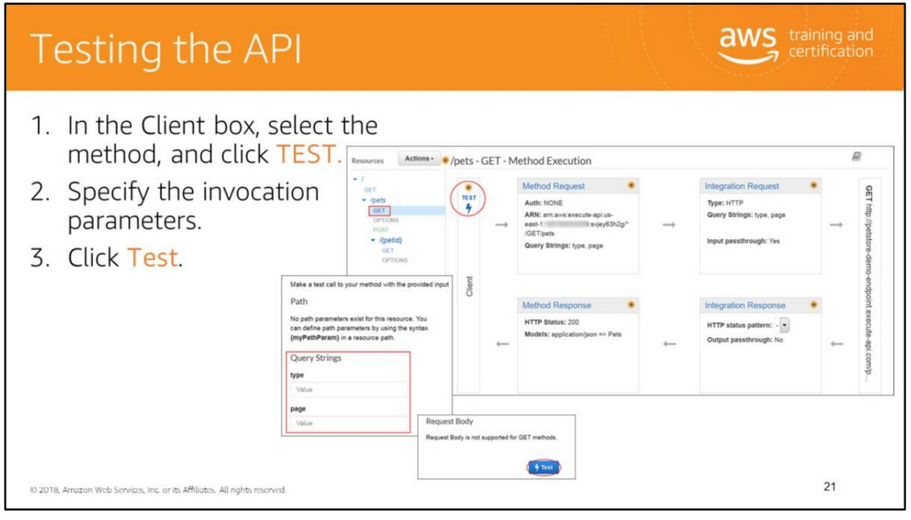
To view the details of a method, modify its setup, or to test it, click the method name from the resource tree.
This displays the Method Execution pane, which presents a logical view of the chosen method's structure and behaviors:
• Method Request and Method Response are the API's interface with the API's frontend (a client).
• Integration Request and Integration Response are the API's interface with the backend (integration endpoint).
The Amazon Resource Name (ARN) is the internal identification of the integration endpoint that is invoked.
It has different formats depending on the endpoint type.

Slide 22
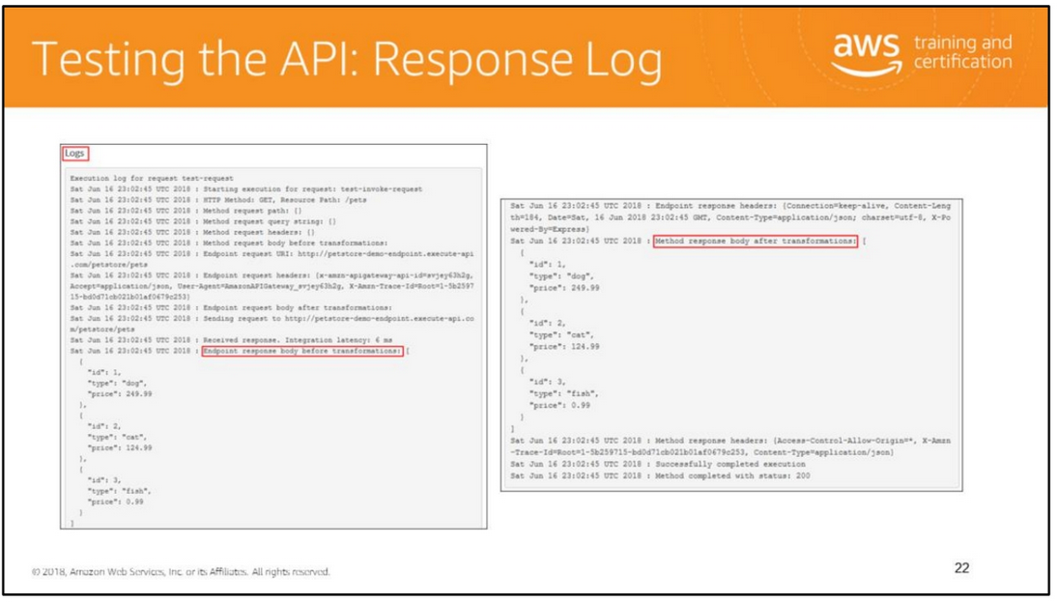
The Logs entry of the output shows the state changes from the method request to the integration request, and from the integration response to the method response.
This can be useful for troubleshooting any mapping errors that cause the request to fail. In this example, no mapping transformations were applied.

Slide 23
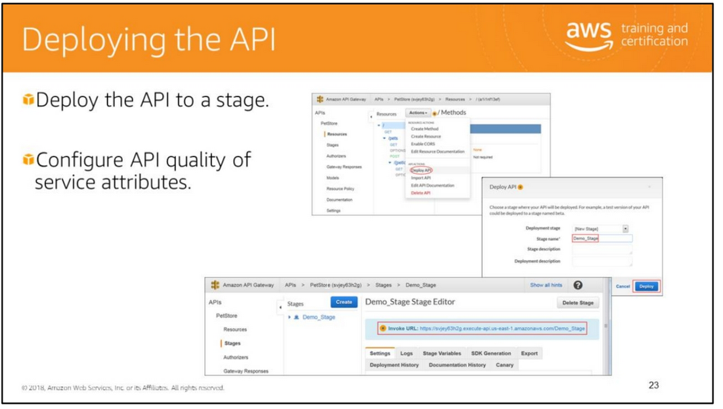
To test the API using a client other than the API Gateway test-invoke-request feature, you must first deploy it to a stage.
Stages are meant to help with the development lifecycle of an API. For example, when you first build your API, you deploy it to a development stage.
When you are ready for production, you can then deploy it to a production stage.
Once the deployment process is finished, the Stage Editor pane is displayed showing the URL to invoke the API's GET / method request in the Invoke URL field.
The State Editor also allows you to manage and optimize a particular deployment.
For example, you can set up stage settings to enable caching, customize request throttling, configure logging, or define stage variables.
The next slides describe these deployment qualities of service in more detail.

Slide 24
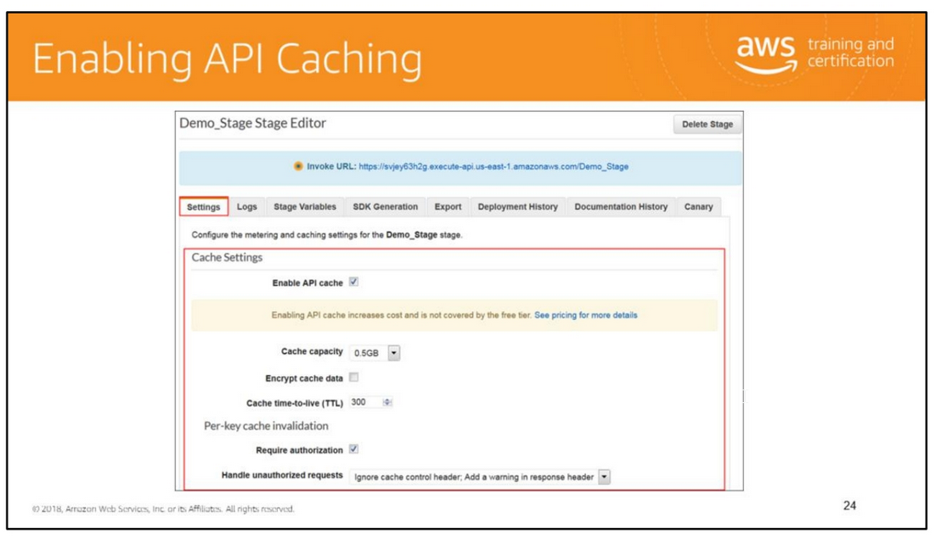

Slide 25
You can add caching to API calls by provisioning an Amazon API Gateway cache and specifying its size in gigabytes.
The cache is provisioned for a specific stage of your APIs.
This improves performance and reduces the traffic sent to your back end. Cache settings allow you to control the way the cache key is built and the time-to-live (TTL) of the data stored
for each method. Amazon API Gateway also exposes management APIs that help you invalidate the cache for each stage.
To enable API caching, select the Enable API cache option under the Cache Settings section.
Then, choose desired options and associated values for Cache capacity, Encrypt cache data, Cache time-to-live (TTL), as well as the requirements for Per-key cache invalidation.
The minimum and maximum values for Cache capacity are 0.5GB and 237GB, respectively.
The default TTL value for API caching is 300 seconds. The maximum TTL value is 3600 seconds. TTL=0 means caching is disabled.
You can set-up cache invalidation by a client to require authorization and choose how unauthorized requests are handled from one of three ways:
• Fail the request with 403 status code: Return a 403 Unauthorized response.
Ignore cache control header; Add a warning in response header: Process the request and add a warning header in the response.
• Ignore cache control header: Process the request and do not add a warning header in the response.

Slide 26
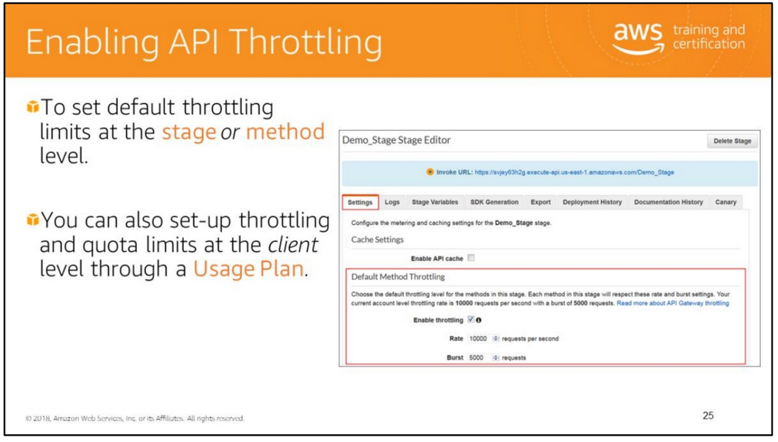
As an API developer, you can set the limits for individual API stages or methods to improve overall performance across all APIs in your account.
The two limits that you can set are:
• Rate: Average number of request per seconds over an extended period of time (Steady-state request rate). The default value is 10,000 requests per second.
• Burst: Maximum number of concurrent requests that API Gateway can fulfill at any moment.
The default value is 5,000 requests. If this limit is exceeded, API Gateway returns an HTTP 429 Too Many Requests error respons.
Note that default method throttling limits are bounded by the account-level rate limits and will never exceed them at runtime even if you specify higher values.
As an alternative, to throttle requests at the client level, you can define a Usage Plan. In addition to throttling, a usage plan also allows to impose request quotas.
The creation of a usage plan is described later in this unit.

Slide 27
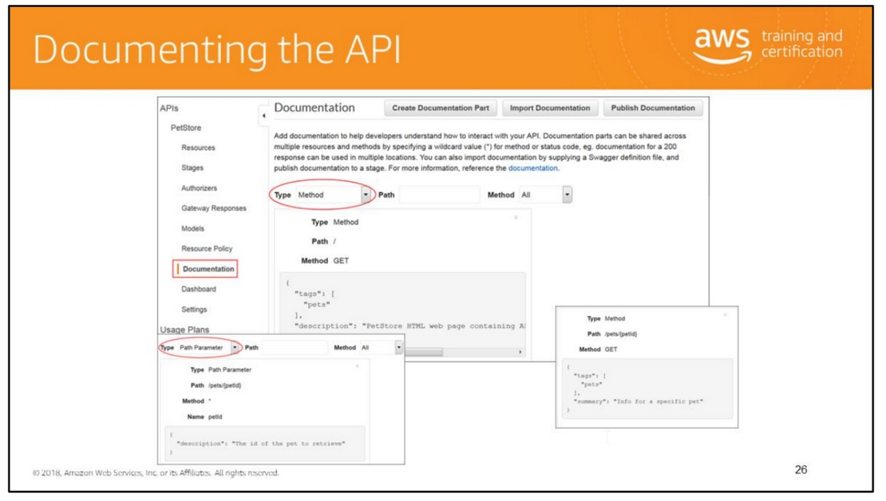
Document your API To help developers understand the behaviors, and the input and output formats of your API.
API Gateway API documentation consists of individual documentation parts associated with specific API entities that include API, resource, method, request, response, message parameters
(path, query, and header), as well as authorizers and models.
API Gateway offers the ability to create, update, and delete documentation associated with each portion of your API.
You can access documentation-related APIs through the AWS SDKs, CLI, via RESTful calls, or by editing the documentation strings directly in the API Gateway console.
Documentation can also be imported as a Swagger file, either as part of the API or separately, allowing you to add or update the documentation without disturbing the API definition.
API Gateway conforms to the Open API specification for documentation imported from, or exported to, Swagger files.

Slide 28
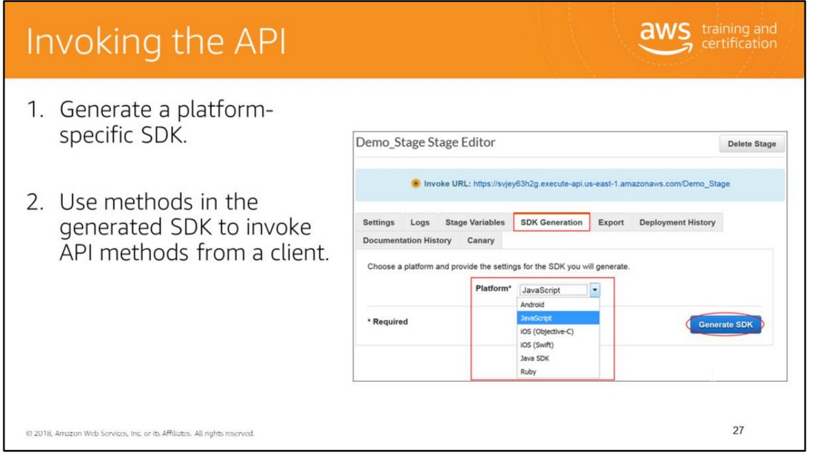
To call your API programmatically, you must generate a platform or language-specific SDK for it.
Currently, API Gateway supports generating an SDK for an API in Java, Java for Android, JavaScript, Objective-C, Swift, and Ruby.
To generate an SDK:
In the Stage Editor’s SDK Generation tab, in the Platform drop-down box, select the target platform.
2. Specify any additionally required parameters, which vary by platform.
3. Click Generate SDK, and then follow the on-screen directions to download the zip file containing the generated SDK.
Important: Every time you update an API, you must redeploy it and regenerate the SDK to include the updates.
For instructions on how to use the generated SDK for each platform, see “Call API through Generated SDKs” at
https://docs.aws.amazon.com/apigateway/latest/developerguide/how-to-call-api-using-generated-sdk.html

Slide 29
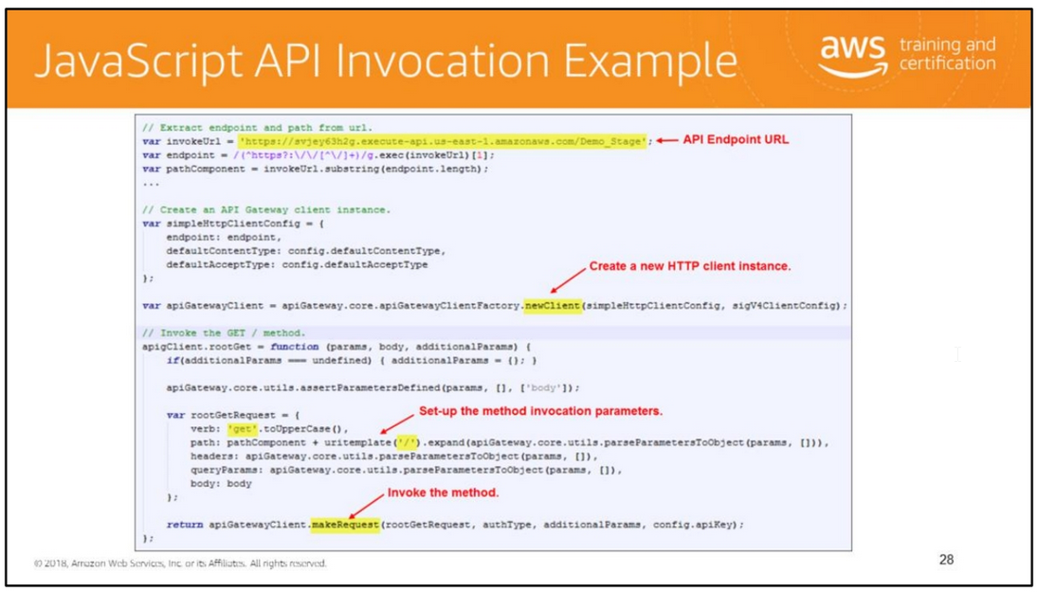
This slide shows the JavaScript code provided in the generated SDK to invoke the Pet Store GET / method (Home page).
Note that some code was omitted to simplify the example.

Slide 30
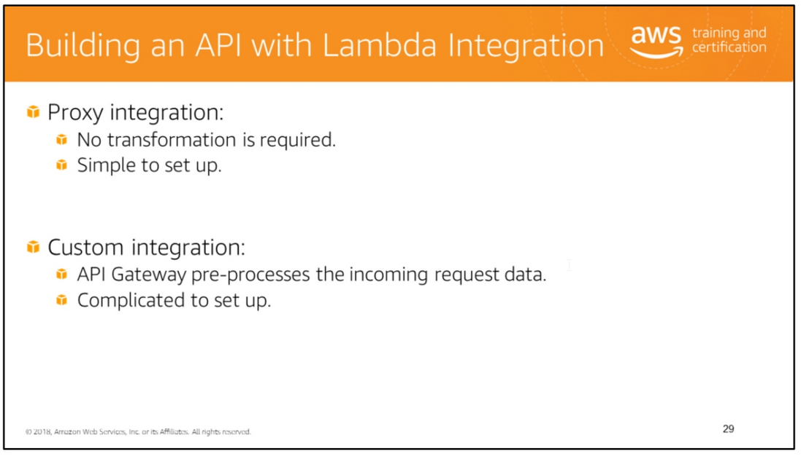
Proxy Integration
With the Lambda proxy integration, the setup is simple because the input to the integrated Lambda function is the as-is input request from the client.
This includes the request headers, query string parameters, URL path variables, payload, and API configuration data.
The configuration data can contain the current deployment stage name, stage variables, the user identity, and the authorization context if present.
For example, if the API does not require data transformation, you need to set only the integration's HTTP method to POST, the integration endpoint URI to the ARN of the Lambda function,
and the credential to an IAM role with permissions to allow API Gateway to call the Lambda function.
In addition, the Lambda function can use the API configuration settings to influence its execution logic.
After its setup, the integrated API method can evolve with the backend without modifying the existing settings.
This possible because the backend Lambda function developer parses the incoming request data and responds with results to the client.
In general, you should use the Lambda proxy integration approach for a nimble and streamlined API setup while providing versatile and powerful features.
The custom integration is more difficult to setup and a legacy technology. In addition, the existing setup is likely to be inoperable when the backend Lambda function requires changes
in its input or output.
Custom Integration With the Lambda custom integration, the setup is more involved. In addition to the proxy integration setup steps,
you must also specify how the incoming request data is mapped to the integration request, and how the resulting integration response data is mapped to the method response.
In addition, you must map errors returned by the Lambda function in the integration response to standard HTTP error responses for the client.
Otherwise, by default, Lambda function errors are returned as 200 OK responses, giving the client a false status.

Slide 31
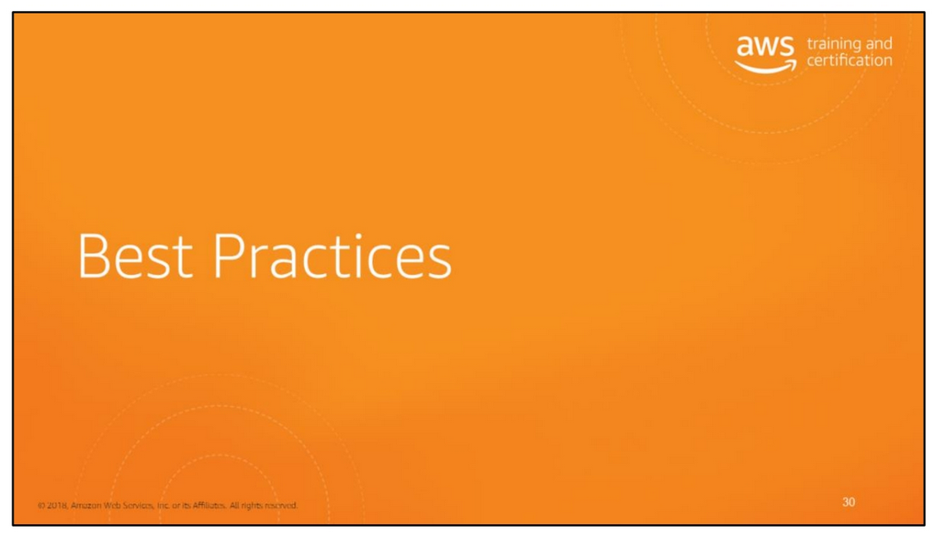

Slide 32
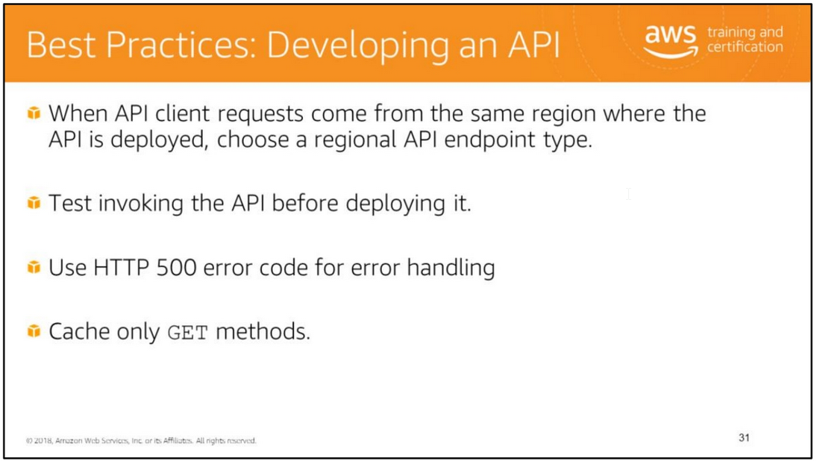
When API requests predominantly originate from an EC2 instance or services within the same region where the API is deployed, a regional API endpoint will typically lower the latency
of connections and is therefore recommended for such scenarios.
It is a good practice to designate the 500 response as the default for unknown or unmapped responses from the backend.
Enabling CloudWatch Logs can help in troubleshooting issues with API invocations.
Similarly, by enabling Detailed CloudWatch Metrics, you can monitor caching, latency and invocation errors at a fine-grained level and set-up alarms to get notifications when issues occur.

Slide 33
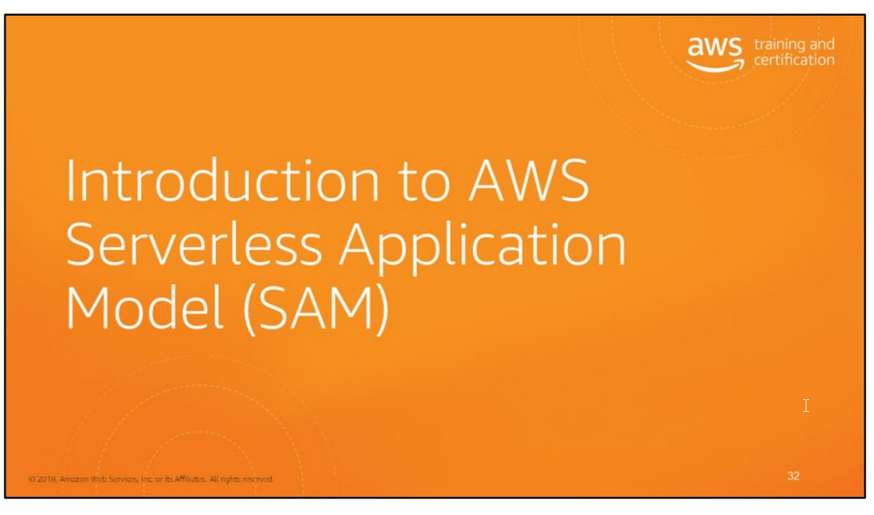

Slide 34
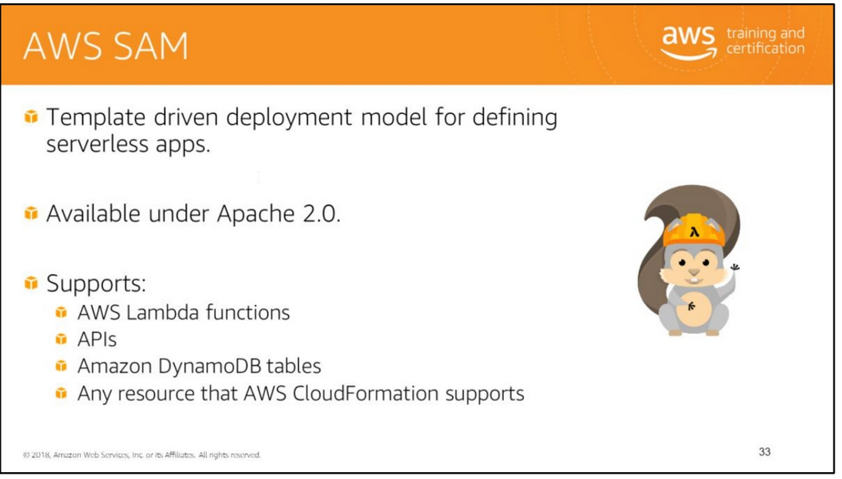
AWS SAM is an AWS CloudFormation extension that is optimized for serverless resources.
For specifications on AWS SAM, see https://github.com/awslabs/serverless-application-model.

Slide 35
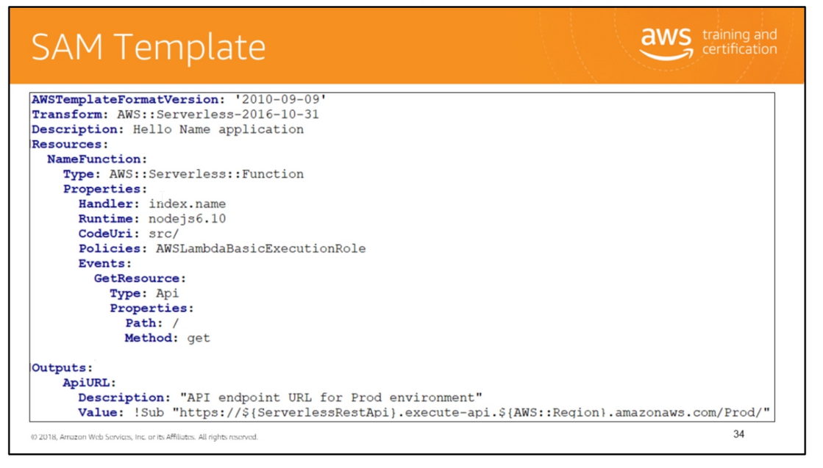

Slide 36

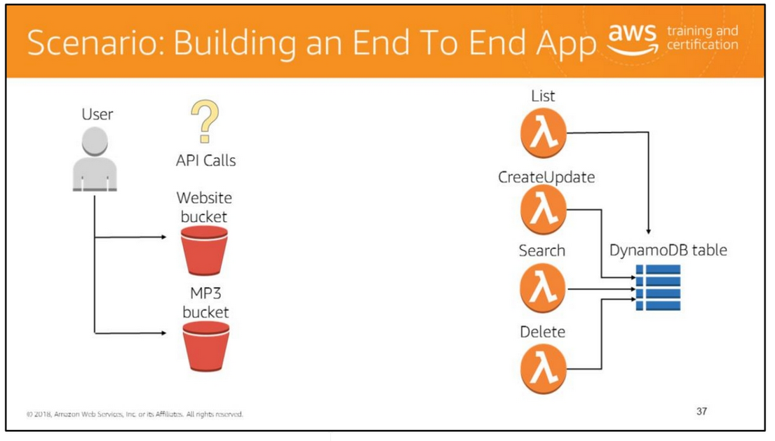
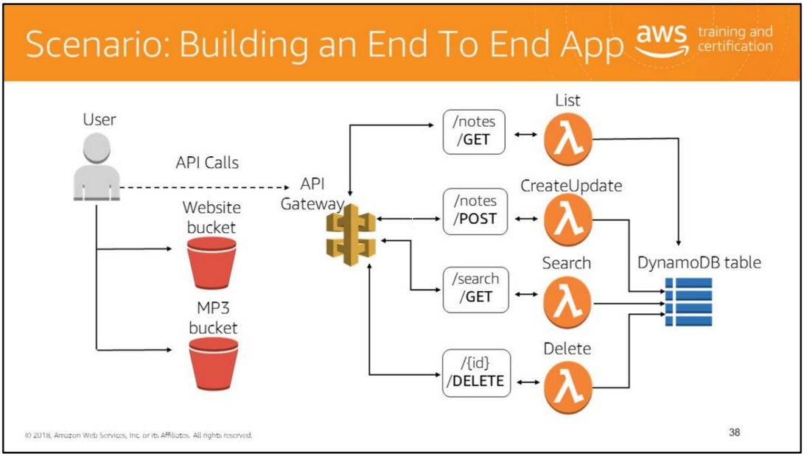

Slide 37

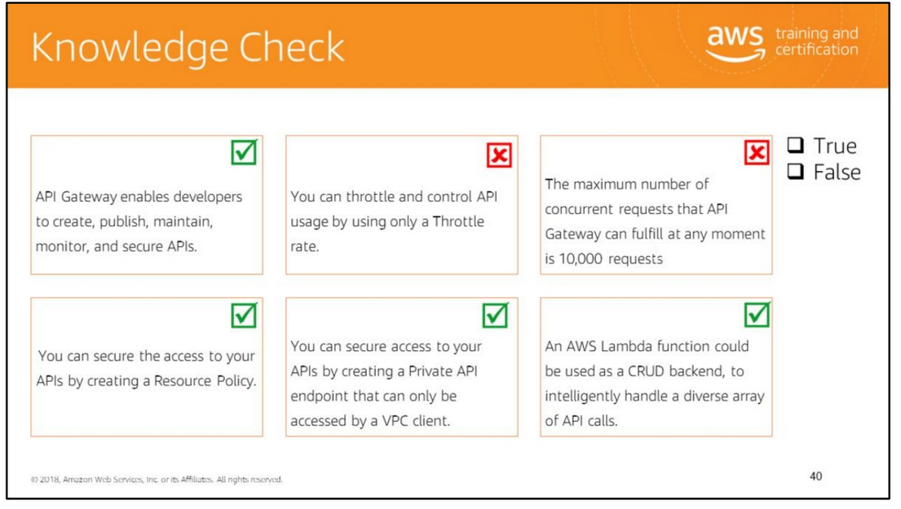
Read left to right:
(True)
(False) You can throttle and control API usage by using a client usage throttling and quota limits specified in a Usage Plan.
(False) The maximum number of concurrent requests that API Gateway can fulfill at any moment is 5,000 requests, the default value. (True)
(True)
(True)

Slide 38
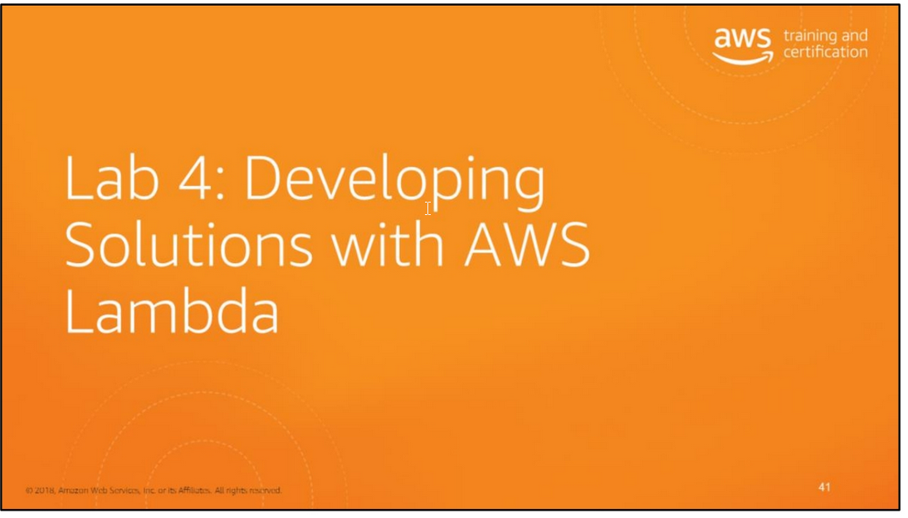
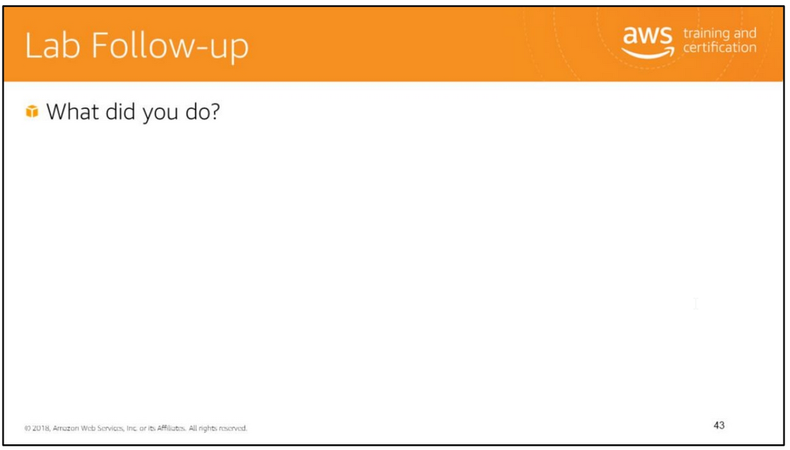
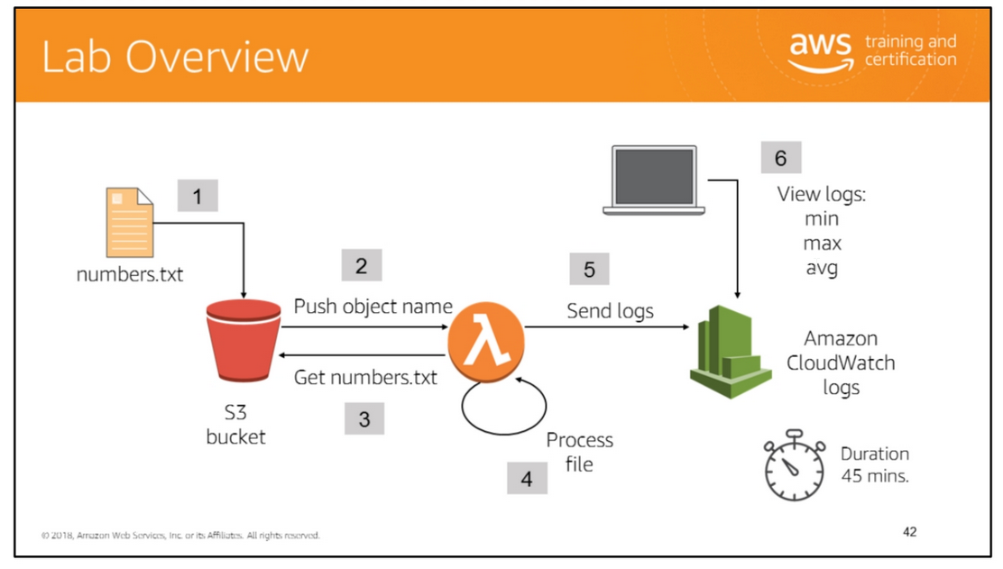
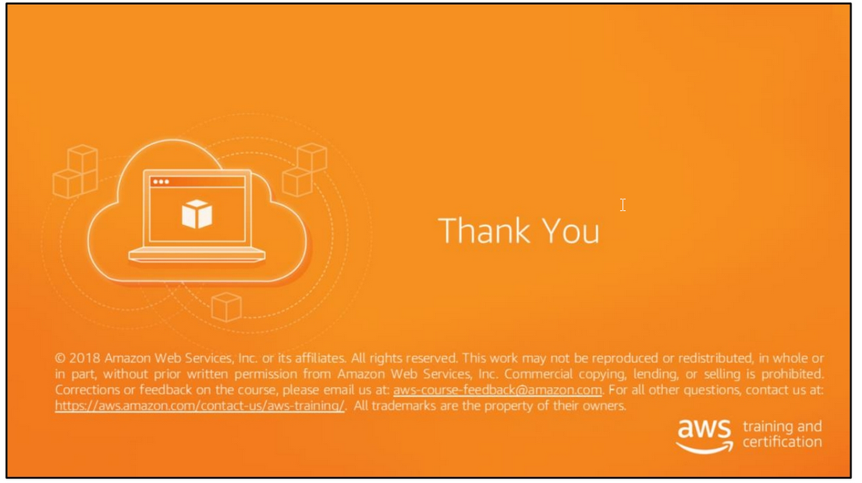
In the lab, you will:
• Create an Amazon IAM Lambda Execution Role.
• Create an AWS Lambda function.
• Configure AWS Lambda function event sources.
• Monitor a Lambda function by using Amazon CloudWatch.
• Retrieve objects from an Amazon S3 bucket.

Slide 39
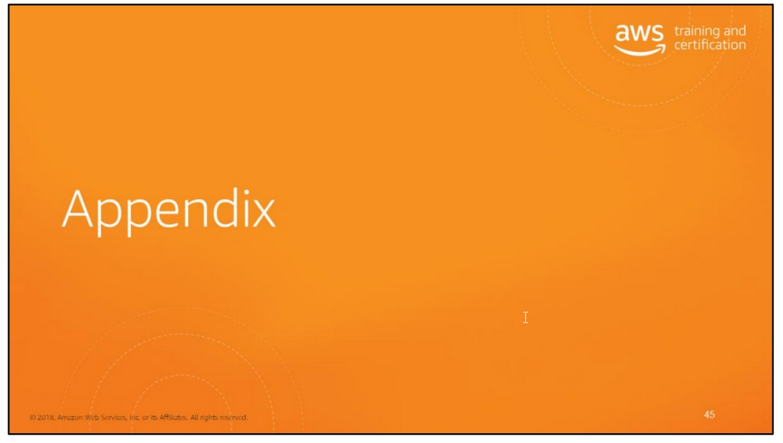

Slide 40
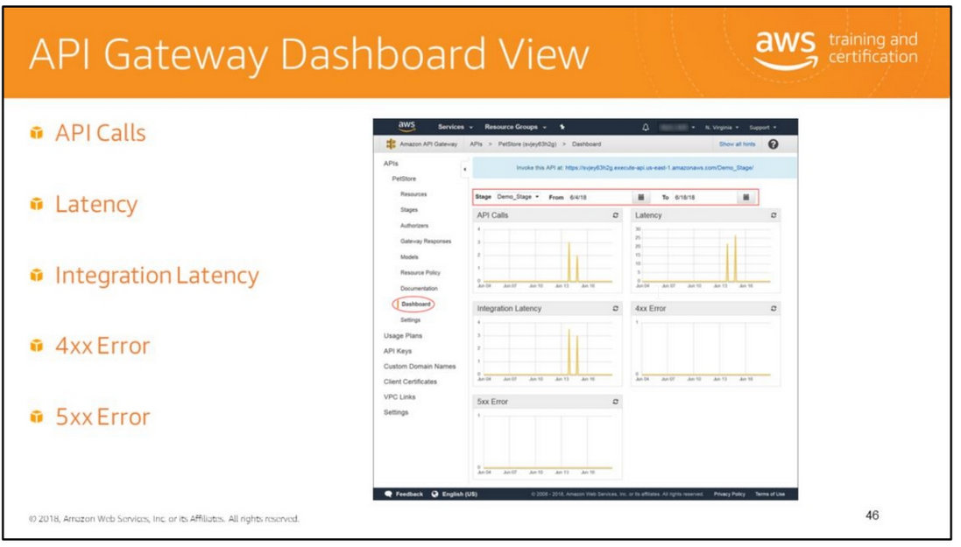
For a given API, the Dashboard view displays graphs for the following metrics in a stage during a specified period of time:
• API Calls: Total number of API requests in the period.
• Latency: Time between when API Gateway receives a request from a client and when it returns a response to the client (Unit: Millisecond).
It includes the integration latency and other API Gateway overhead.
• Integration Latency: Time between when API Gateway relays a request to the backend and when it receives a response from the backend (Unit: Millisecond).
• 4xx Error: Number of client-side errors captured in the period.
• 5xx Error: Number of server-side errors captured the period.
Clicking a data point in a graph opens the Amazon CloudWatch console where you can further display and analyze the same metrics.

